Slide 1
ML Visuals
Notes:
ML Visuals is a new collaborative effort to help the machine learning community in improving science communication by using more professional, compelling and adequate visuals and figures. You are free to use the visuals in your presentations or blog posts. You don’t need to ask permission to use any of the visuals but it will be nice if you can provide credit to the designer/author (author information found in the slide notes).
This is a project made by the dair.ai community and maintained in this GitHub repo. Our community members will continue to add more common figures and basic elements in upcoming versions. Think of this as free and open artefacts and templates which you can freely and easily download, copy, distribute, reuse and customize to your own needs.
To add your own custom figures, simply add a new slide and reuse any of the basic visual components (remember to request edit permissions). You can also create your own copy of the slides and customize whatever you like. We encourage authors/designers to add their visuals here and allow others to reuse them. Make sure to include your author information (in the notes section of the slide) so that others can provide credit if they use the visuals elsewhere (e.g. blog/presentations). Also, provide a short description of your visual to help the user understand what it is about and how they can use it. If you need "Edit" permission, just click on the "request edit access" option under the "view only" toolbar above or send me an email at ellfae@gmail.com.
Downloading a figure from any of the slides is easy. Just click on File→Download→(choose your format).
If you need help with customizing a figure or have an idea of something that could be valuable to others, we can help. Just open an issue here and we will do our best to come up with the visual. Thanks.
Feel free to ask us anything related to this project in our Slack group.

Slide 2
Basic components https://github.com/dair-ai/ml-visuals
Notes:
Note:
Basic components go here.

Slide 3
Notes:
Note:
This is a simple round rectangle that can represent some process, operation, or transformation
Author: Elvis Saravia

Slide 4
Notes:
Note:
Can represent a neuron or some arbitrary operation
Author: Elvis Saravia

Slide 5




Softmax
Convolve
Sharpen
Notes:
Note:
These visuals could represent transformations (left) or operations (right)
The visuals on the right use the Math Equations Add on for Google Slides. You won’t be able to directly modify the equation here. Install the add on and just generate the operation that you need.
Author: Elvis Saravia

Slide 6
Notes:
Note:
This can be used to represent a vector. If you want to edit the distance between each element, you can “ungroup” the shapes and then modify the distance between the individual lines.
Author: Elvis Saravia

Slide 7
Notes:
Note:
Can represent a multidimensional array (2D)
Author: Elvis Saravia

Slide 8
Notes:
Note:
These visuals can represent a multi-directional array (3D)
Author: Elvis Saravia

Slide 9
output
input
Notes:
Note:
This diagram could represent a simple logistic regression model; you can generalize to deep neural network by adding layers (see next slide)
Author: Elvis Saravia

Slide 10
Notes:
Note:
1 hidden layer neural network
Author: Elvis Saravia

Slide 11
Frameworks/Models
Notes:
Note:
In this section we add common ML frameworks or models

Slide 12
Softmax
Linear
Add & Norm
Feed
Forward
Add & Norm
Add & Norm
Multi-Head
Attention
Feed
Forward
Add & Norm
Add & Norm
Masked
Multi-Head
Attention
Multi-Head
Attention
Positional
Encoding
Positional
Encoding
Input
Embedding
Output
Embedding
Inputs
Outputs (shifted right)
Notes:
Note:
Using the same visual components from before and a few new custom ones, I was able to come up with the Transformer architecture
This is a reproduction of the Transformer architecture figure presented in the work of Vaswani et al. 2017
You can further customize it however you want
Author: Elvis Saravia

Slide 13
I
love
coding
and
writing
Tokenize
“I love coding and writing”
Notes:
Note:
This figure aims to demonstrate the process of tokenization
If you want to change the gradient colors of this shape, you can simply click on the shape and then select “Fill color” (the bucket looking icon at the top).
This is a gradient color so you can customize however you want
Author: Elvis Saravia

Slide 14
ML Concepts
Notes:
Note:
Gradient background shows some inspirations and ideas for color themes that could be used for backgrounds
The examples used in this section are inspired by https://uigradients.com

Slide 15
Size
Family?
X
Y
#bed
Walk?
PRICE ŷ
Basic Neuron Model
ZIP
School
How does NN work (Coursera)
Wealth
Ŷ = 0
X
Logistic Regression
Ŷ = 1
Notes:
By @srvmshr

Slide 16
$
$
ReLU(x)
Size
Size
Linear regression
256
225
56
.
.
.
214
210
211
NxN
NxN
NxN
NxN
R-G-B
Notes:
By @srvmshr

Slide 17
256
225
56
.
.
.
214
210
211
NxN
NxN
NxN
NxN
R-G-B
Unrolling Feature vectors
Notes:
By @srvmshr

Slide 18
Large NN
Med NN
η
Small NN
SVM,LR etc
Amount of Data
Why does Deep learning work?
Notes:
By @srvmshr

Slide 19
Hidden
Input
Output
a^{[1]}₁
a^{[1]}₂
One hidden layer neural network
X
a^{[2]}
Ŷ
a^{[1]}₃
a^{[1]}₄
X = A^{[0]}
A^{[1]}
A^{[2]}
Notes:
By @srvmshr

Slide 20
a^{[1]}₁
x_{[1]}
a^{[2]}
a^{[1]}₂
x_{[2]}
x_{[1]}
x_{[2]}
x_{[3]}
Neural network templates
Notes:
By @srvmshr

Slide 21
Train
Valid
Test
Underfitting
Good fit
Overfitting
x2
x2
x2
x1
x1
x1
Train-Dev-Test vs. Model fitting
Notes:
By @srvmshr

Slide 22
x_{[1]}
x_{[2]}
a_{[L]}
DropOut
x_{[3]}
x2
r=1
x2
Normalization
x1
x1
Notes:
By @srvmshr

Slide 23
J
w2
Early stopping
Err
w1
w1
w2
Before Normalization
Dev
Train
it.
J
w2
w1
w1
After Normalization
w2
Notes:
By @srvmshr

Slide 24
x₁
x₂
w[L]
w[1]
w[2]
w[L-2]
w[L-1]
Deep neural networks
FN
TN
TP
FP
Understanding
Precision & Recall
Notes:
By @srvmshr

Slide 25
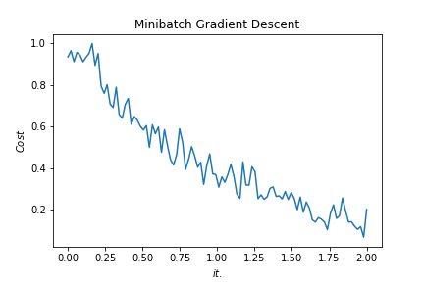
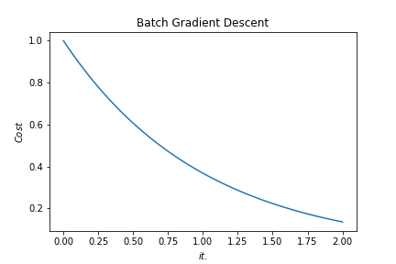
Batch vs. Mini-batch Gradient Descent
w2
w2
BGD
SGD
Mini-batch Gradient Descent vs. SGD
SGD
w1
w1
Notes:
By @srvmshr

Slide 26
x_{[1]}
p_{[1]}
x_{[2]}
p_{[2]}
x_{[3]}
Softmax Prediction with 2 outputs
Notes:
By @srvmshr

Slide 27
Abstract backgrounds
Notes:
Note:
You can add abstract backgrounds here

Slide 28
Notes:
Note:
You can change the gradient of each component
Author: Elvis Saravia

Slide 29
Text
Notes:
Note:
This is the header I use for the dair.ai NLP Newsletter
You can change the gradient of each component
You can customize the background as well by right clicking and changing to another gradient or static color
Author: Elvis Saravia

Slide 30
Notes:
Note:
This is the header I use for the dair.ai NLP Newsletter
You can change the gradient of each component
Author: Elvis Saravia

Slide 31
Notes:
Note:
This is the header I use for the dair.ai NLP Newsletter
You can change the gradient of each component
Author: Elvis Saravia

Slide 32
Gradient Backgrounds
Notes:
Note:
Gradient background shows some inspirations and ideas for color themes that could be used for backgrounds
The examples used in this section are inspired by https://uigradients.com

